Slide 1

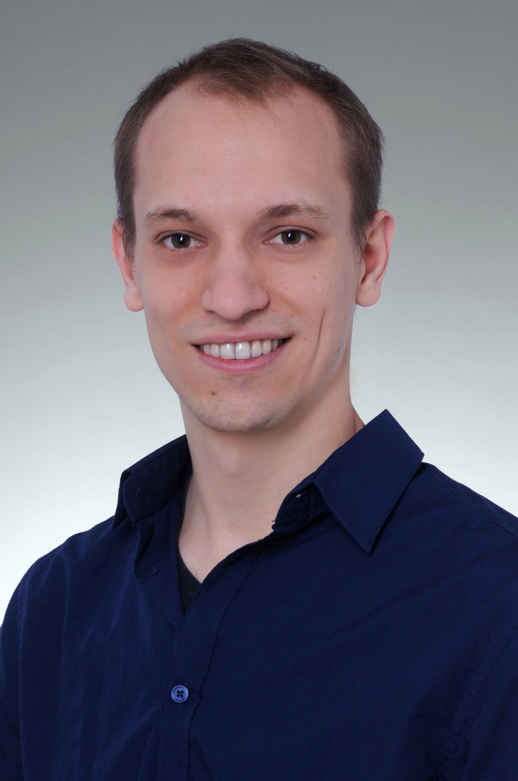
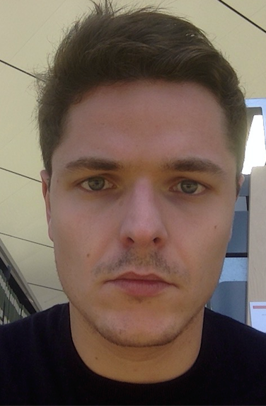
3D Object Recognition with Deep Networks
GROUP MEMBERS:
Tobias Grundmann Adrian Schneuwly Johannes Oswald

Slide 2
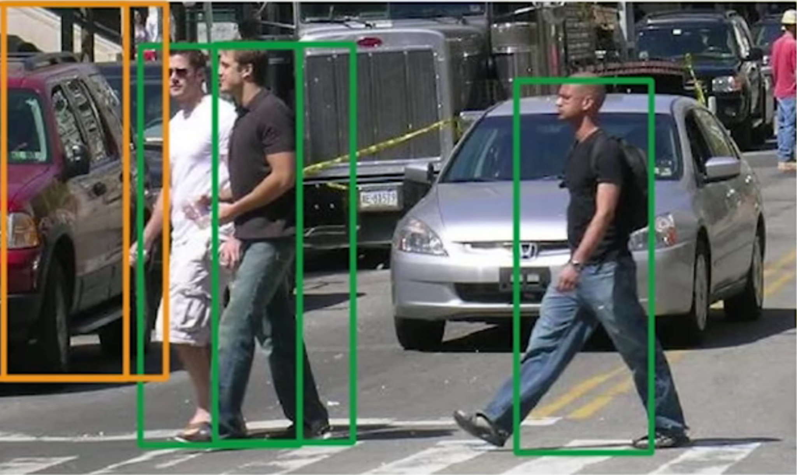
Why is object detection important?

Slide 3
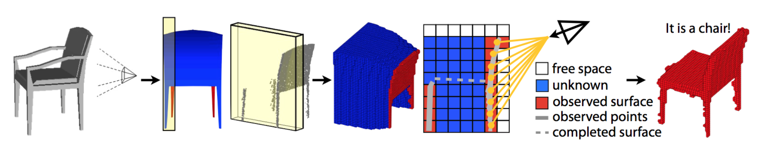
What do we hope to achieve?
Voxelized 3D CAD objects
Occupancy Grid
Depth Data of particular view point
It’s a chair!

Slide 4
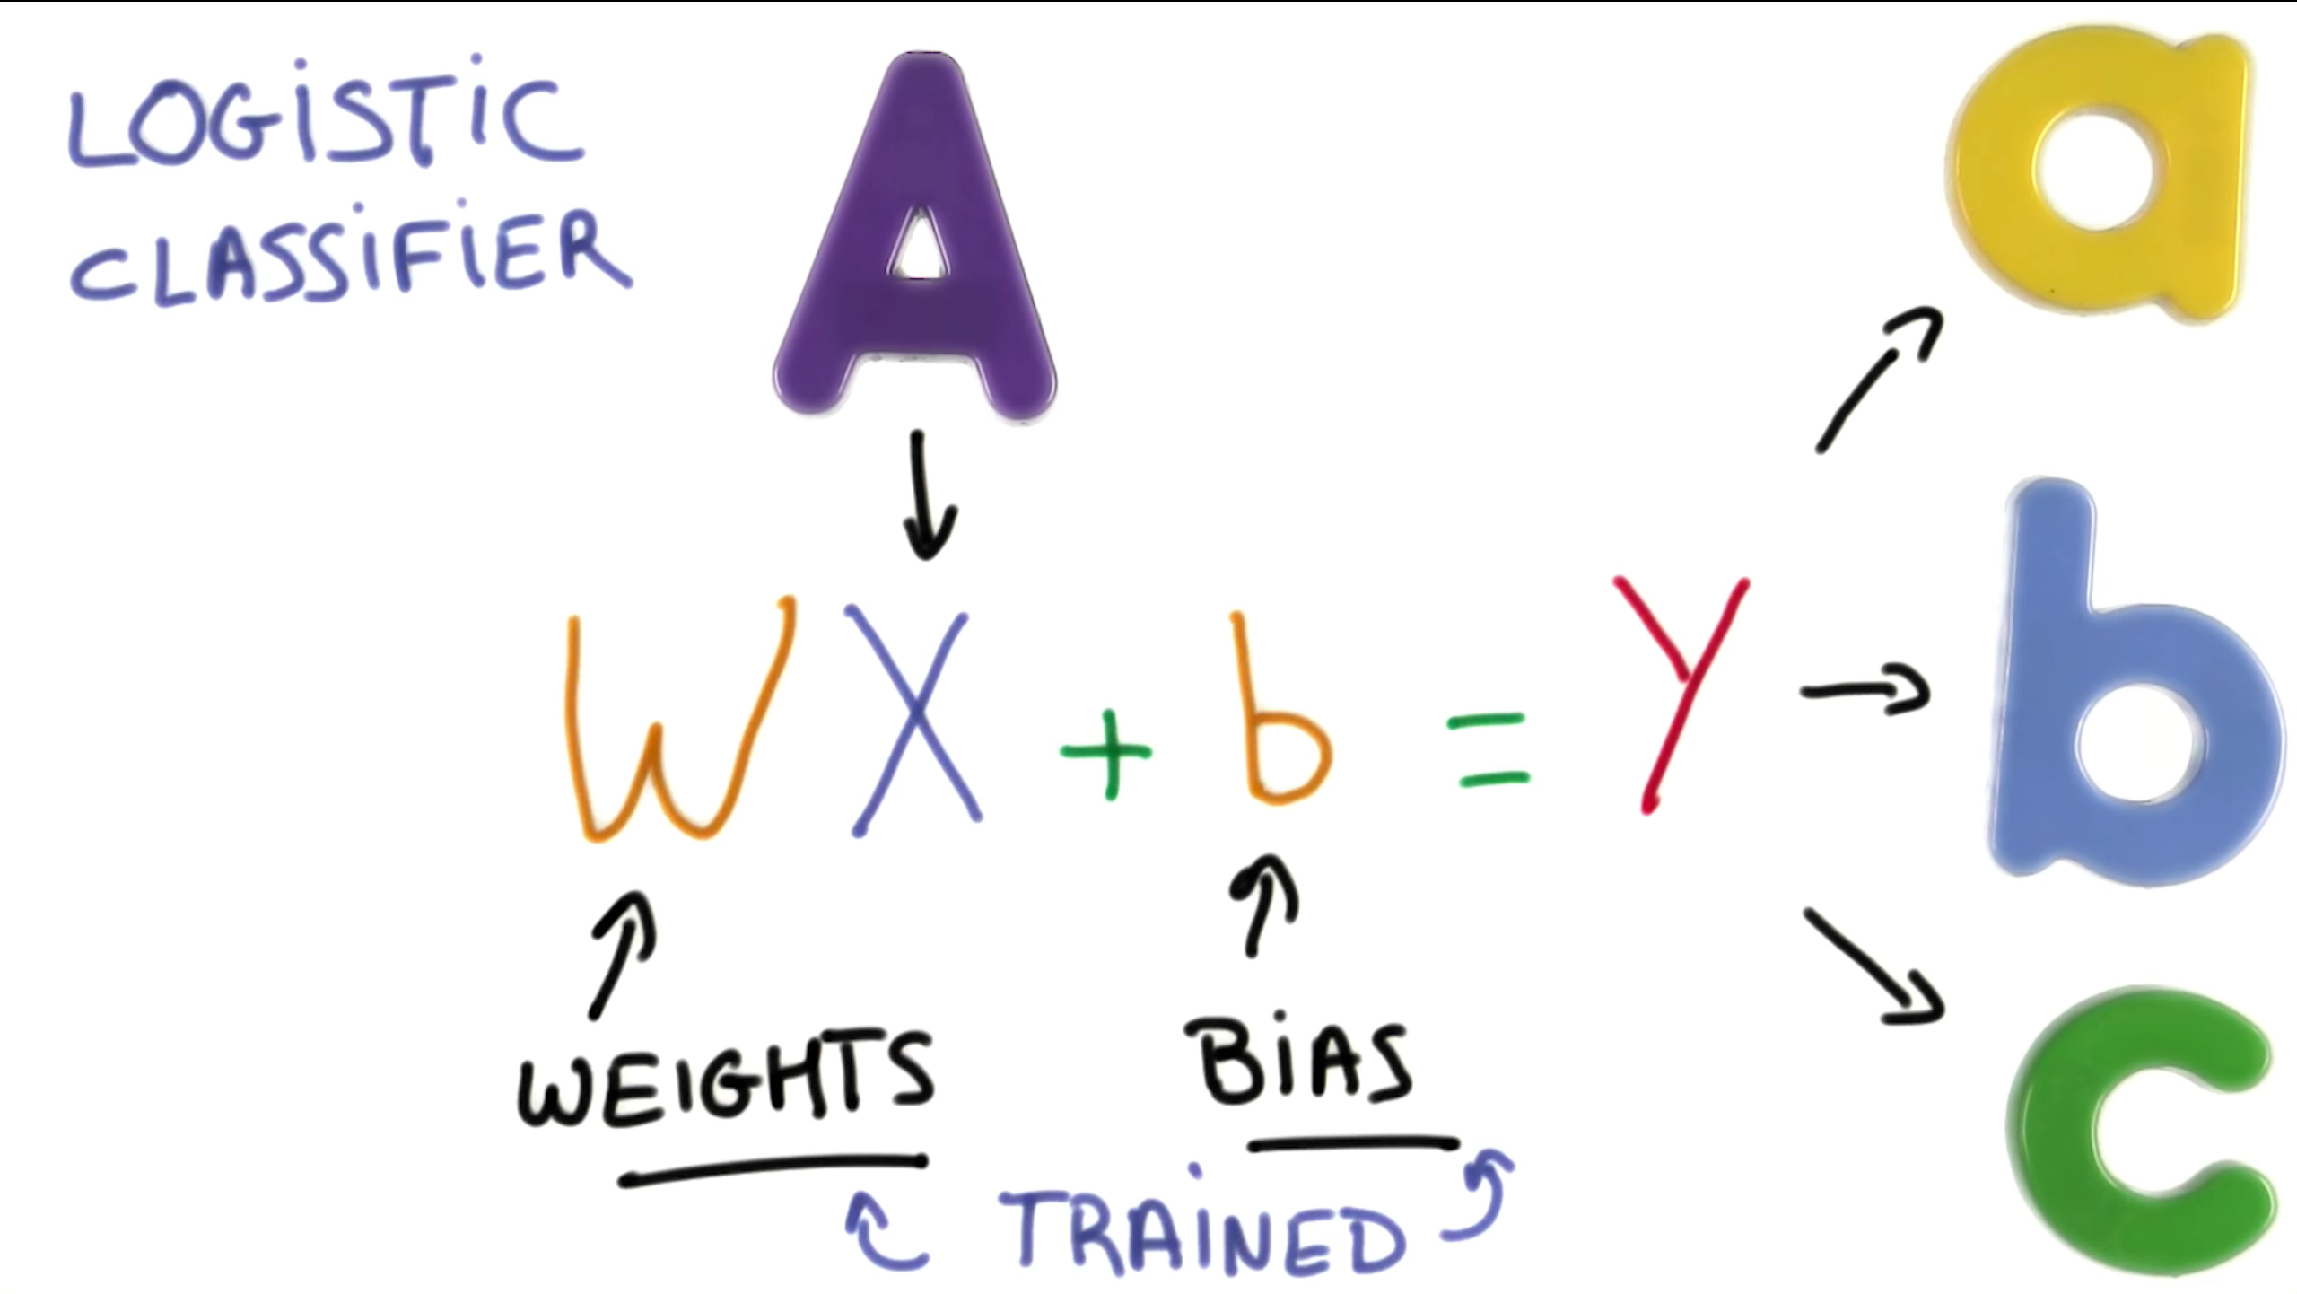
How does our object recognition works?

Slide 5
Timeline
March
Understand 2D Object Recognition with Deep Networks
Get familiar with Machine Learning, Tensorflow, Papers approaches
April
Implement Neural Network
Turn 2D into 3D: What about rotations?
June
Training of our Neural Network: Takes a long time!
Fine tuning and evaluation
Build application for Live Demo

